Slide 1
AWS IoT Graph with AWS Greengrass
W251 - Cloud News
Rishi

Slide 2
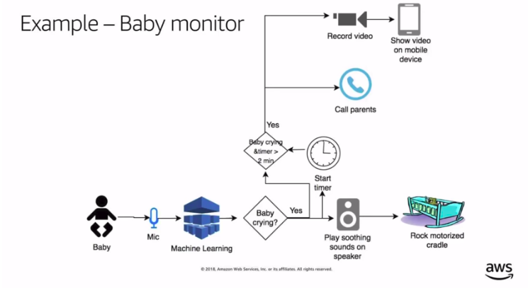
Use Case
Notes:
Multiple IoT devices are connected to make an intelligent decision.

Slide 3
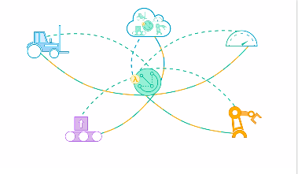
AWS Greengrass
Notes:
Allows to create grouping for multiple devices and bind under a set of rule engine. It also handles interoperability and provides standard across devices.

Slide 4
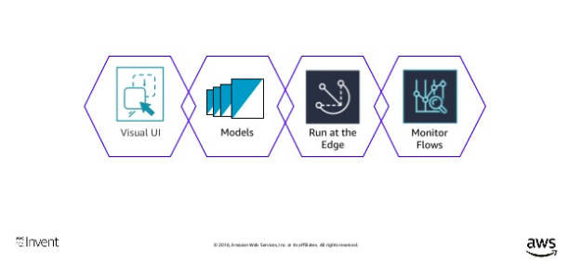
AWS IoT Graph
Notes:
Graph works in association with Greengrass. It makes it easy to visually connect different devices and web services to build IoT applications. Greengrass provides the infrastructure and the Graph takes care of the functionality and event triggering.

Slide 5
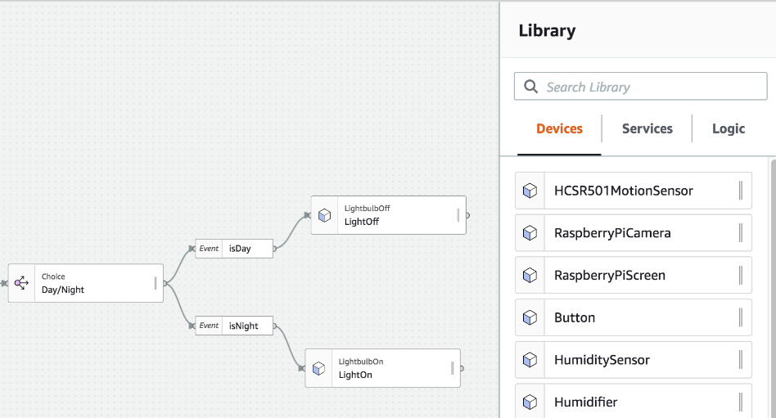
Workflow
Notes:
Can create workflow with different devices and implement a strategy on how they will be connected and coordinated.

Slide 6
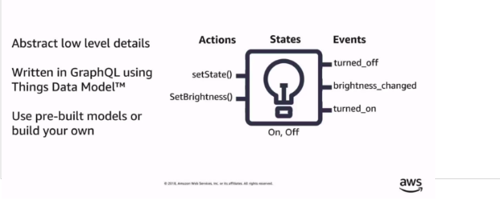
Model

Slide 7
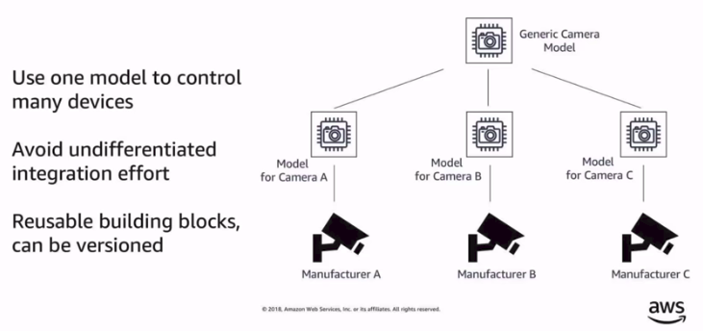
Model (con’t)

Slide 8
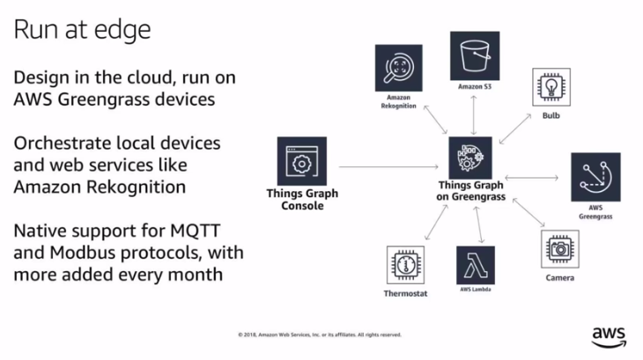

Slide 9
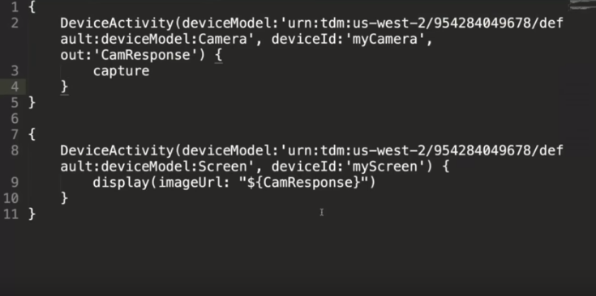
Trigger

Slide 10
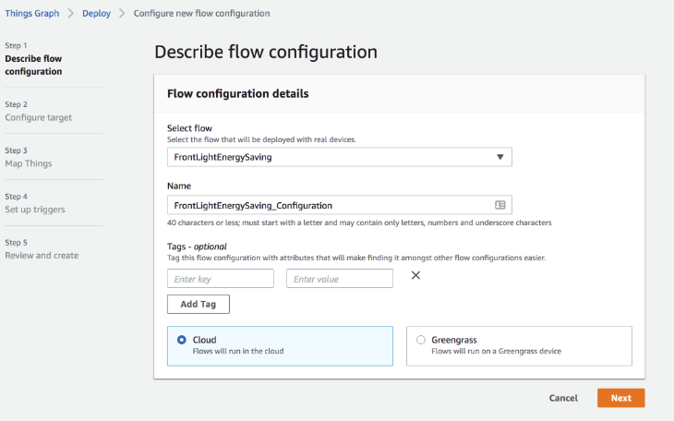
Deployment

Slide 11
Questions?

